Slide 1


HVS​
Concept of DC Charge Management

Slide 2

Contents
DC Charge parameters management
DC Charge mode
DC Charge communication
DC Charge sequential control

Slide 3
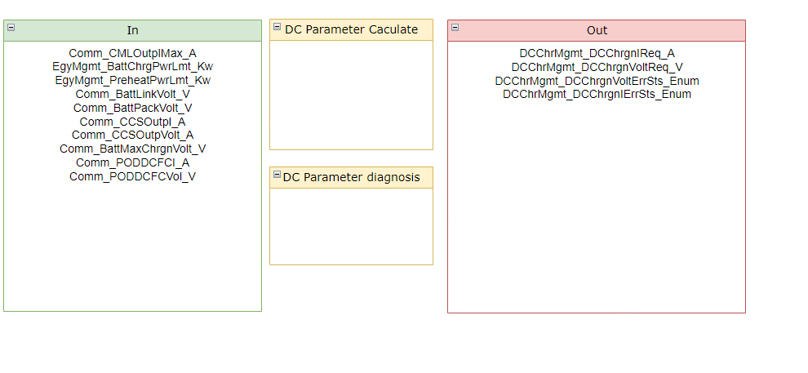
DC Charge parameters management

Slide 4
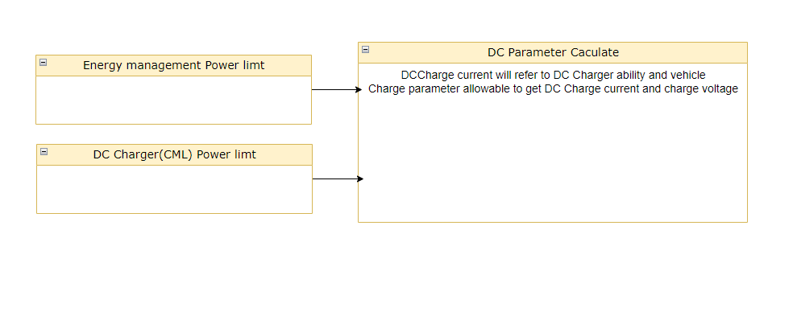
DC Charge parameters management
DC Charge parameters calculate

Slide 5
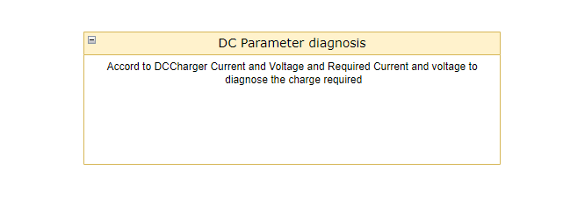
DC Charge parameters management
DC Charge parameters diagnosis

Slide 6
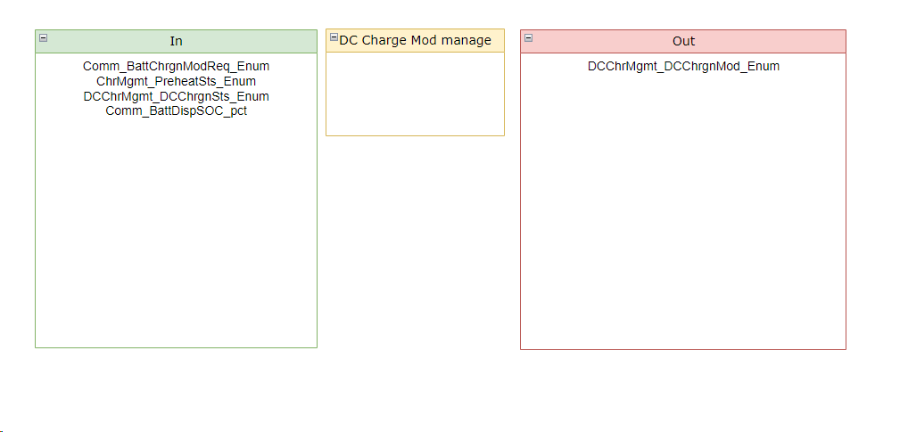
DC Charge Mode

Slide 7
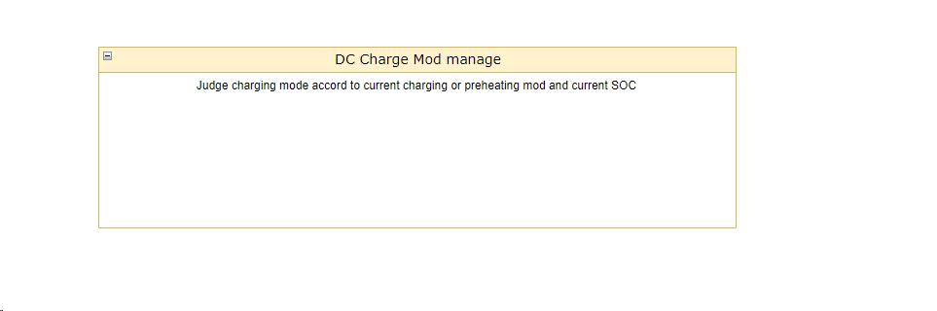
DC Charge Mode

Slide 8
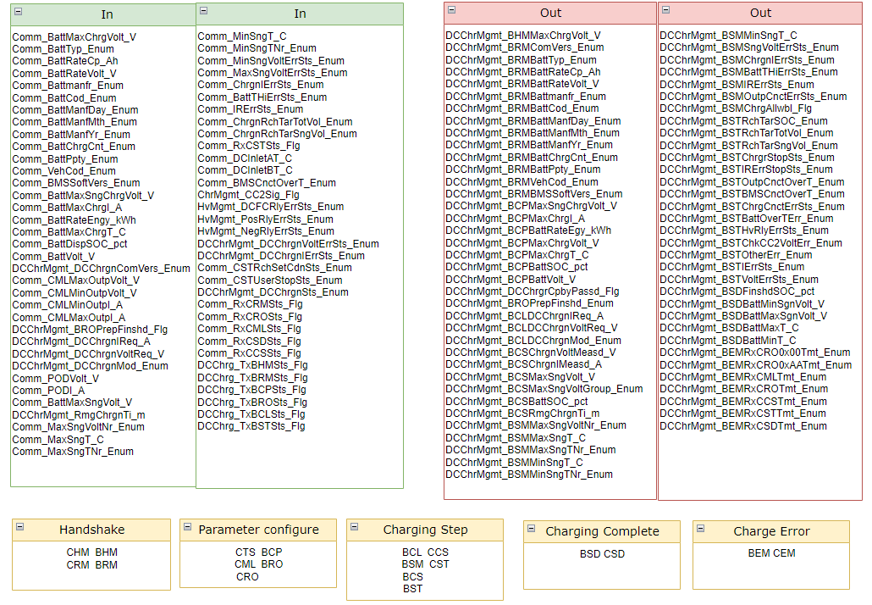
DC Charge communication

Slide 9

DC Charge parameters management
Hand shake stage

Slide 10

DC Charge parameters management
Parameter Configure Stage

Slide 11
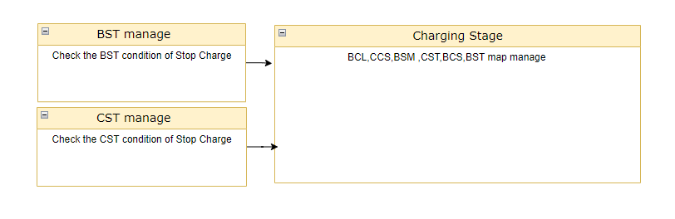
DC Charge parameters management
Charging stage

Slide 12

DC Charge parameters management
Charging complete stage

Slide 13
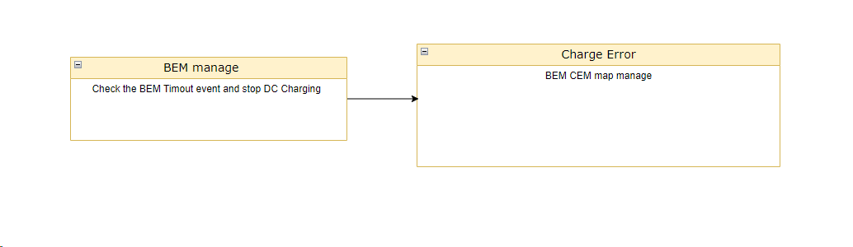
DC Charge parameters management
Charge error stage

Slide 14
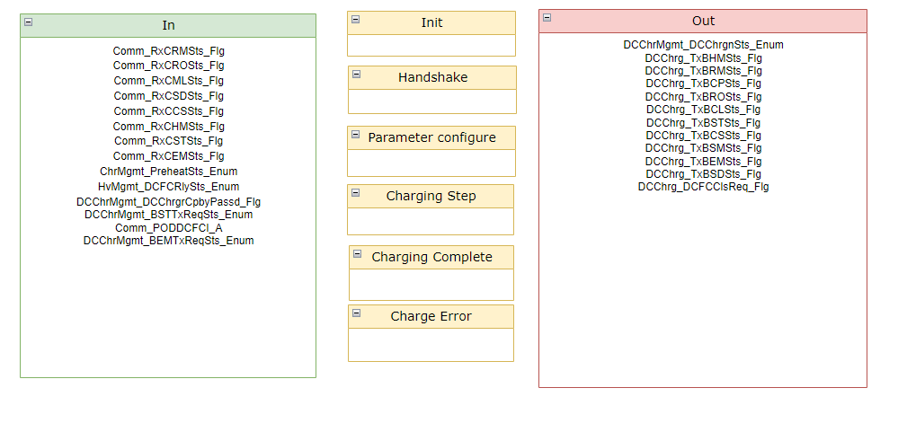
DC Charge sequential control

Slide 15

DC Charge sequential control

Slide 16
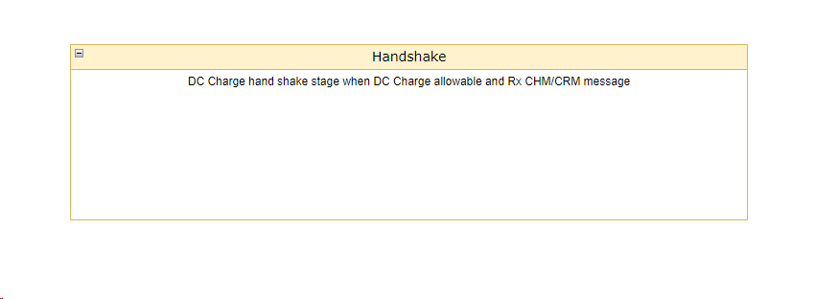
DC Charge sequential control

Slide 17

DC Charge sequential control

Slide 18
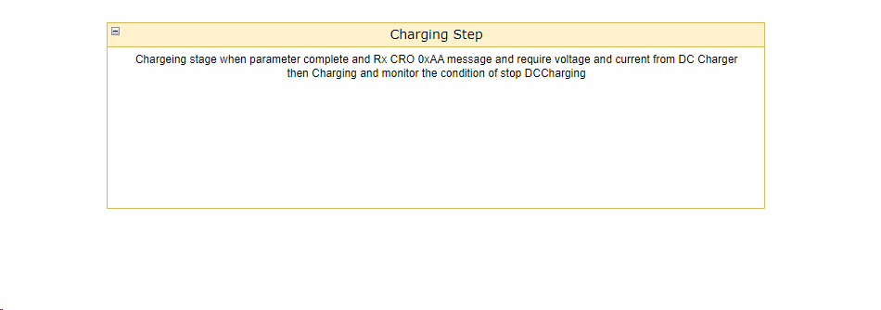
DC Charge sequential control

Slide 19
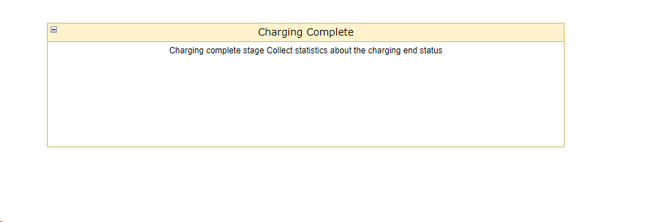
DC Charge sequential control

Slide 20
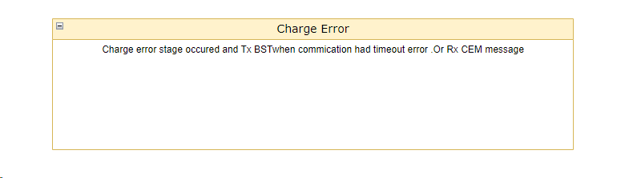
DC Charge sequential control

Slide 21
Backup

